Slide 1
Linear vs Non Linear Classifiers
Presented by:
Komal Patil - 01
Rakesh Patole - 06
Abhishek Pawtekar - 08
Hrishikesh Rajgure - 16
Ajinkya Rode - 23

Slide 2
Content
Introduction
Types of Classifiers:
Linear classifier
Support vector machine
Logistic regression
Non linear classifier
Decision tree
Applications
Conclusion

Slide 3
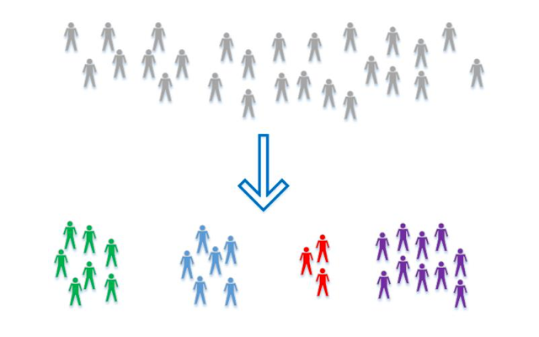
Introduction
Classification is when we use some form of data’s characteristics to determine which group the piece of data falls into.
For example detecting whether a movie review is “good” or “bad”, or grouping email as “spam” or “not spam”.

Slide 4
Types of Classifiers:
Linear classifier
Support vector machine
Logistic regression
Non linear classifier
Decision tree

Slide 5
Linear Classifier
In the field of image processing, the goal of statistical classification is to use an object's characteristics to identify which class (or group) it belongs to.
A linear classifier achieves this by making a classification decision based on the value of a linear combination of the characteristics.
An object's characteristics are also known as feature values and are typically presented to the machine in a vector called a feature vector.

Slide 6
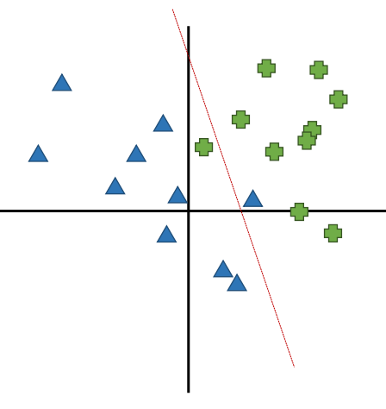
Linear Classifier
If the data are not linearly separable, a linear classification cannot perfectly distinguish the two classes.
In many datasets that are not linearly separable, a linear classifier will still be “good enough” and classify most instances correctly

Slide 7
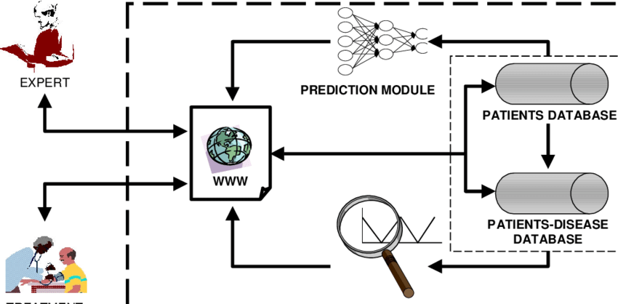
Example of Linear Classifier
With the use of Binary Linear Classifier we can implement solution for some problems.
Detection of Phishing Emails
Medical diagnosis system to predict whether a patient has a given disease

Slide 8
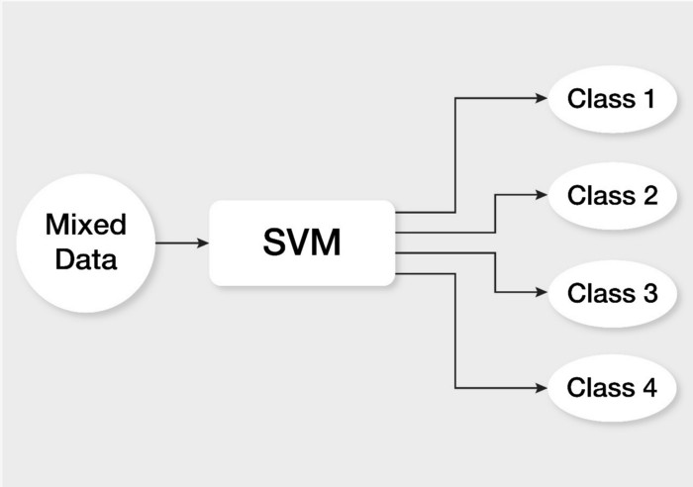
Support Machine Vector
SVM or Support Vector Machine is a linear model for classification.
It can solve linear and non-linear problems and work well for many practical problems.
The idea of SVM is simple: The algorithm creates a line or a hyperplane which separates the data into classes.

Slide 9
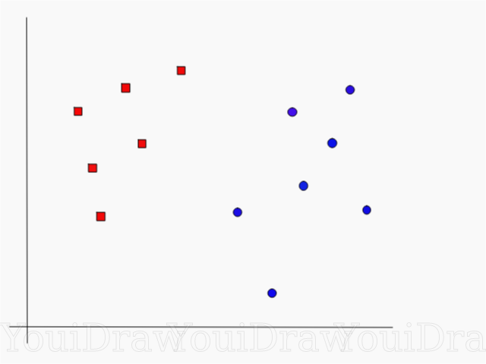
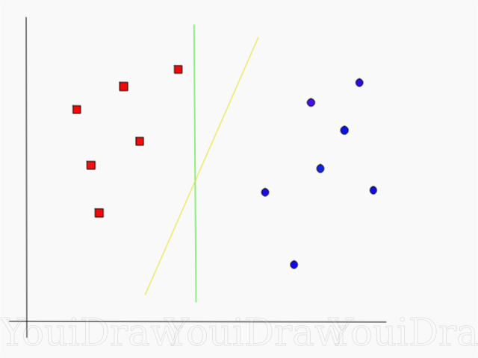
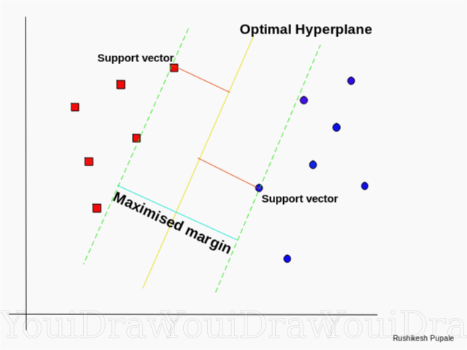
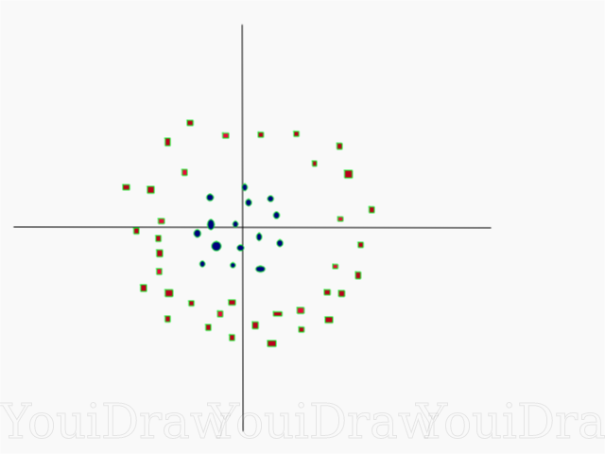
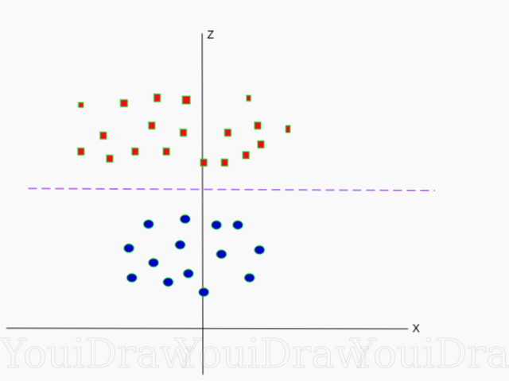
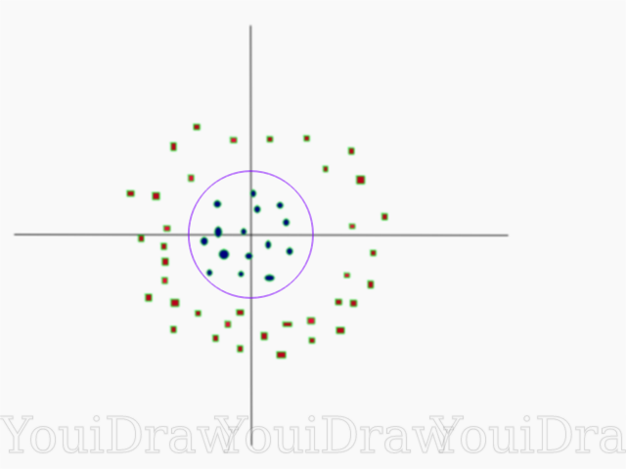
Separation of data using SVM
Linear Data Set:
Non linear Data Set:

Slide 10
Logical Regression
Logistic regression is a classification algorithm, used when the value of the target variable is categorical in nature.
Logistic regression is most commonly used when the data in question has binary output, so when it belongs to one class or another, or is either a 0 or 1.
It is important to understand that logistic regression should only be used when the target variables fall into discrete categories.

Slide 11
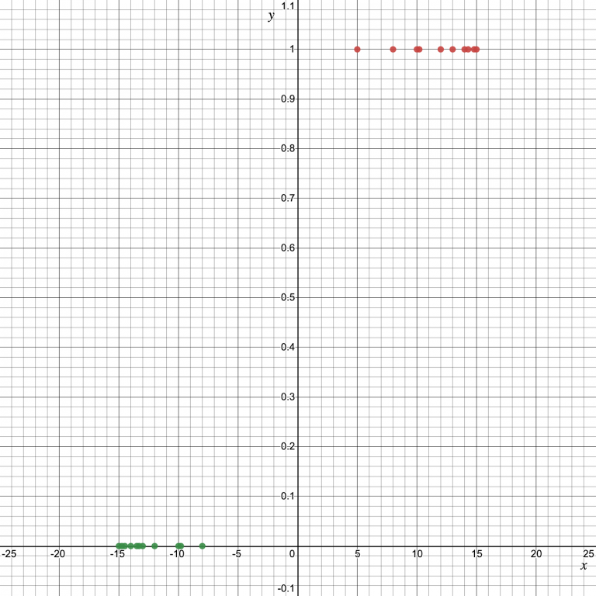
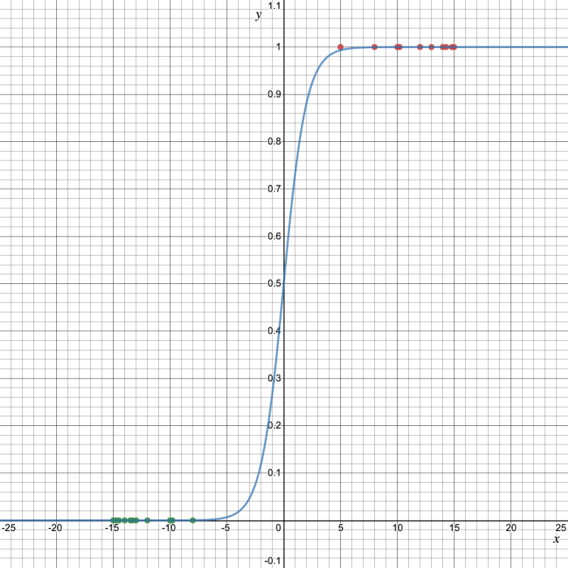
Separation of data using Logistic Regression

Slide 12
Non Linear Classifiers
Non Linear classifiers are used to separate the instances that are not linearly separable.
An example of a nonlinear classifier is kNN. The nonlinearity of kNN is intuitively clear when looking at below example.
Another example is XOR

Slide 13
kNN(K nearest neighbour)
K-nearest neighbors (KNN) algorithm uses ‘feature similarity’ to predict the values of new datapoints which further means that the new data point will be assigned a value based on how closely it matches the points in the training set.
Their are some simple steps by that this algorithm works.
These are two methods: Euclidean, Manhattan or Hamming distance. The most commonly used method to calculate distance is Euclidean.

Slide 14
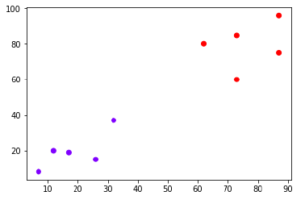
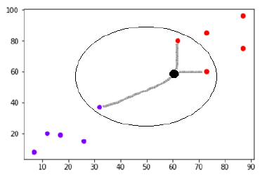
Example
The following is an example to understand the concept of K and working of KNN algorithm .
Suppose we have a dataset which can be plotted as follows −
Concept of K

Slide 15
XOR Problem
A Boolean logic operation that is widely used in cryptography as well as in generating parity bits for error checking and fault tolerance. XOR compares two input bits and generates one output bit. The logic is simple. If the bits are the same, the result is 0. If the bits are different, the result is 1.
It is mostly used in neural networks

Slide 16
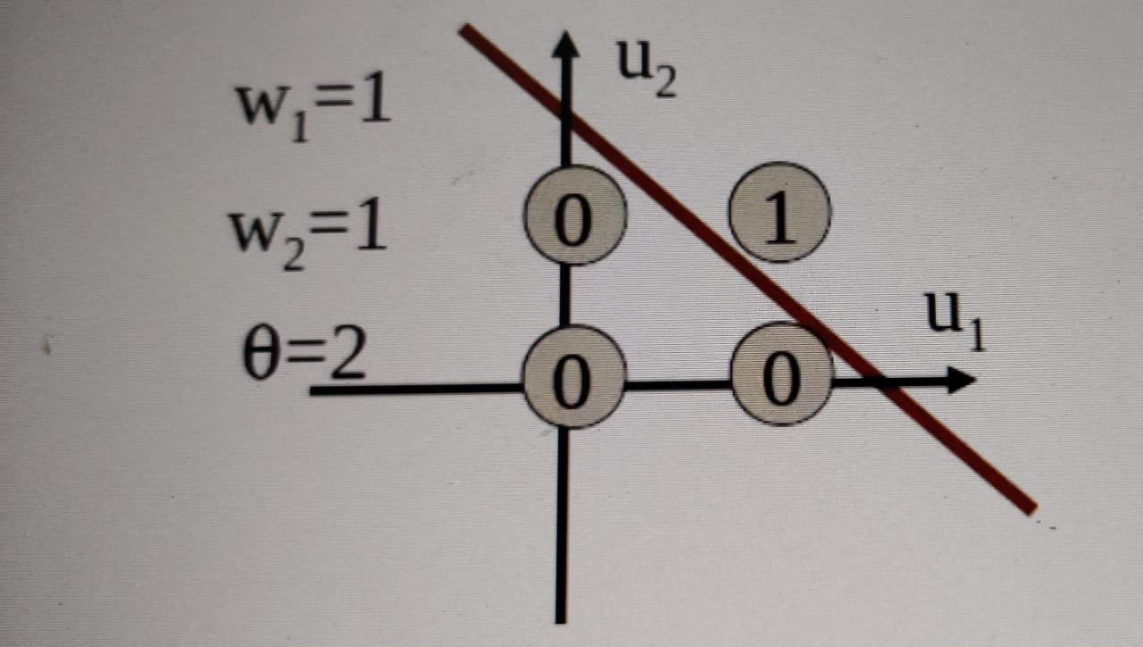
Example
For a two dimesional AND problem the graph looks like this.
When u1 is 1 and u2 is 1 output is 1 and in all other cases it is 0, so if you wanted to separate all the ones from the zeros by drawing a single line, you would just draw the line as in the graph.

Slide 17
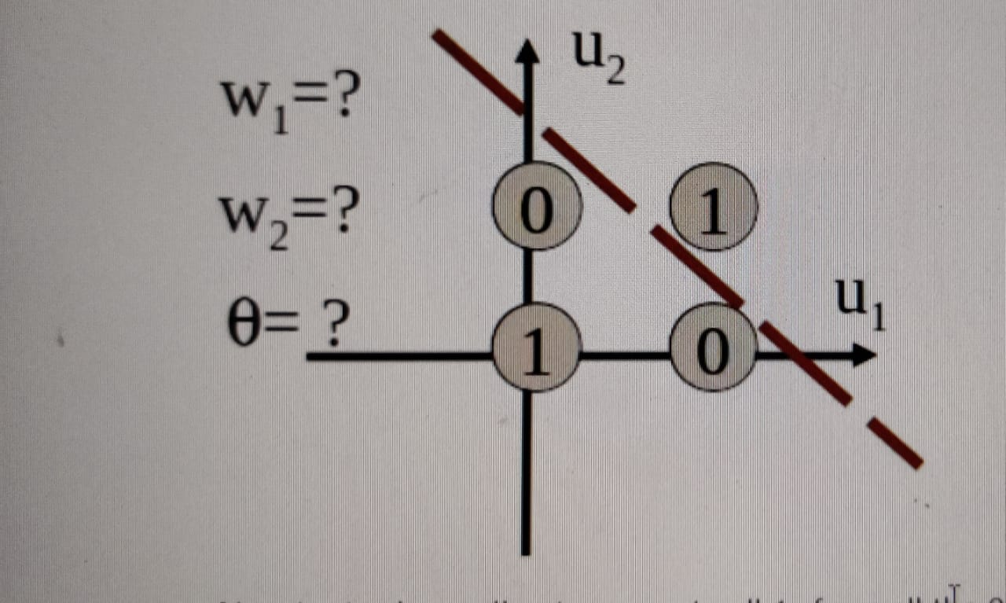
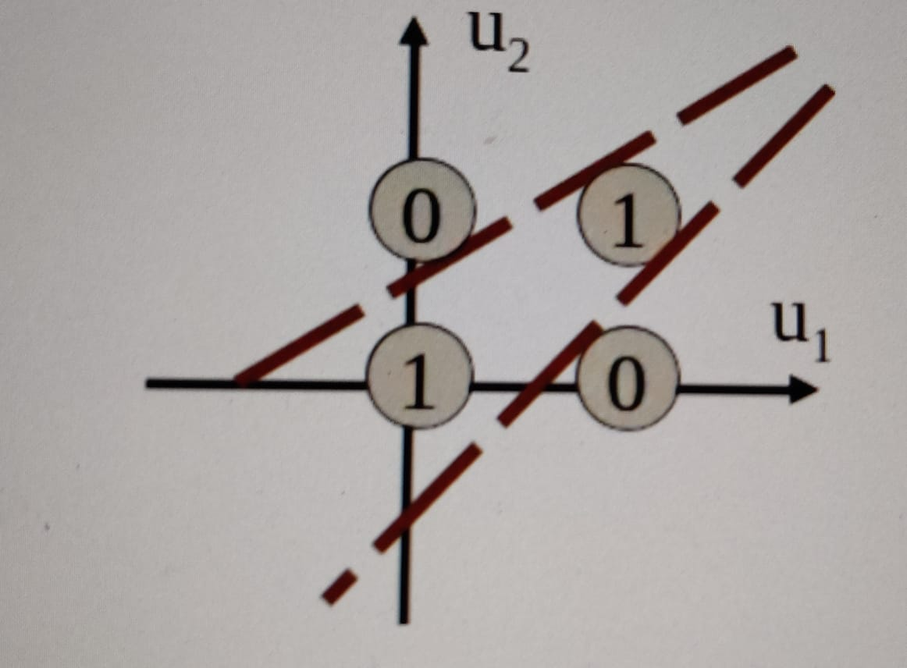
Example
Now try to draw a line to separate all 1s from all the 0s. Can we do this? We can’t. We need to draw another line. That’s why we can’t use perceptrons, we will have to use multiple perceptrons to draw multiple lines. XOR is not Linearly Separable.

Slide 18
Example of Non Linear Classifier
The above problems are called nonlinear classification problems and cannot be solved by drawing a linear classifier, therefore, other alternatives are required.
We may need piece-wise linear (i.e. linear in parts), or non-linear classification boundaries to identify the two classes correctly.

Slide 19
Decision Tree
Decision trees learn from data to approximate a sine curve with a set of if-then-else decision rules.
The deeper the tree, the more complex the decision rules and the fitter the model.
Decision tree builds classification models in the form of a tree structure.

Slide 20
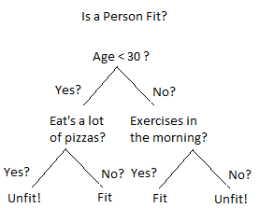
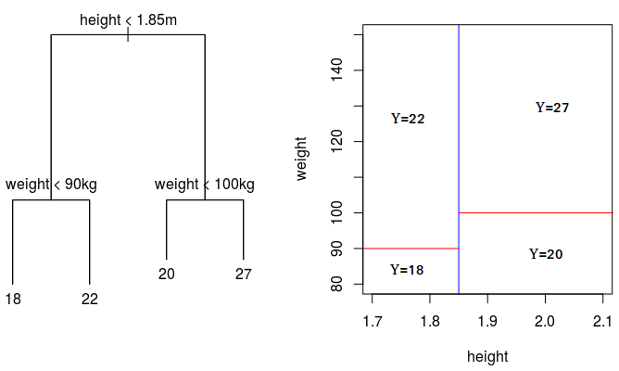
Types of Decision Tree
Classification trees
(Yes/No types)
Regression trees(Continuous data types)

Slide 21
Conclusion

